Slide 1
University of Gdansk
Gdansk, 22 February 2016

Slide 2
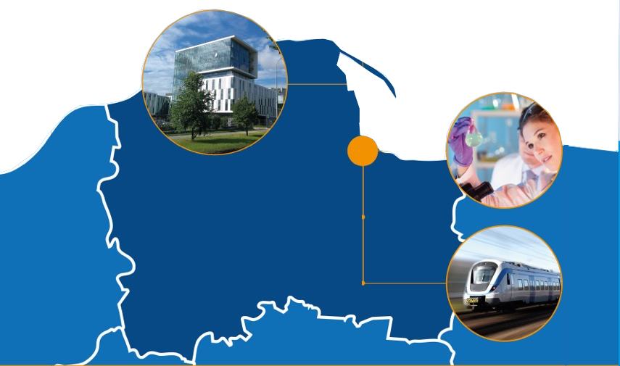
Where are we?
Tri-City (Gdansk, Gdynia, Sopot)
Gdansk, 22 February 2016

Slide 3
Where are we?
Population approx. 800,000
Efficient public transport
Access to highway system
International airport
Ferry connections
Gdansk, 22 February 2016

Slide 4
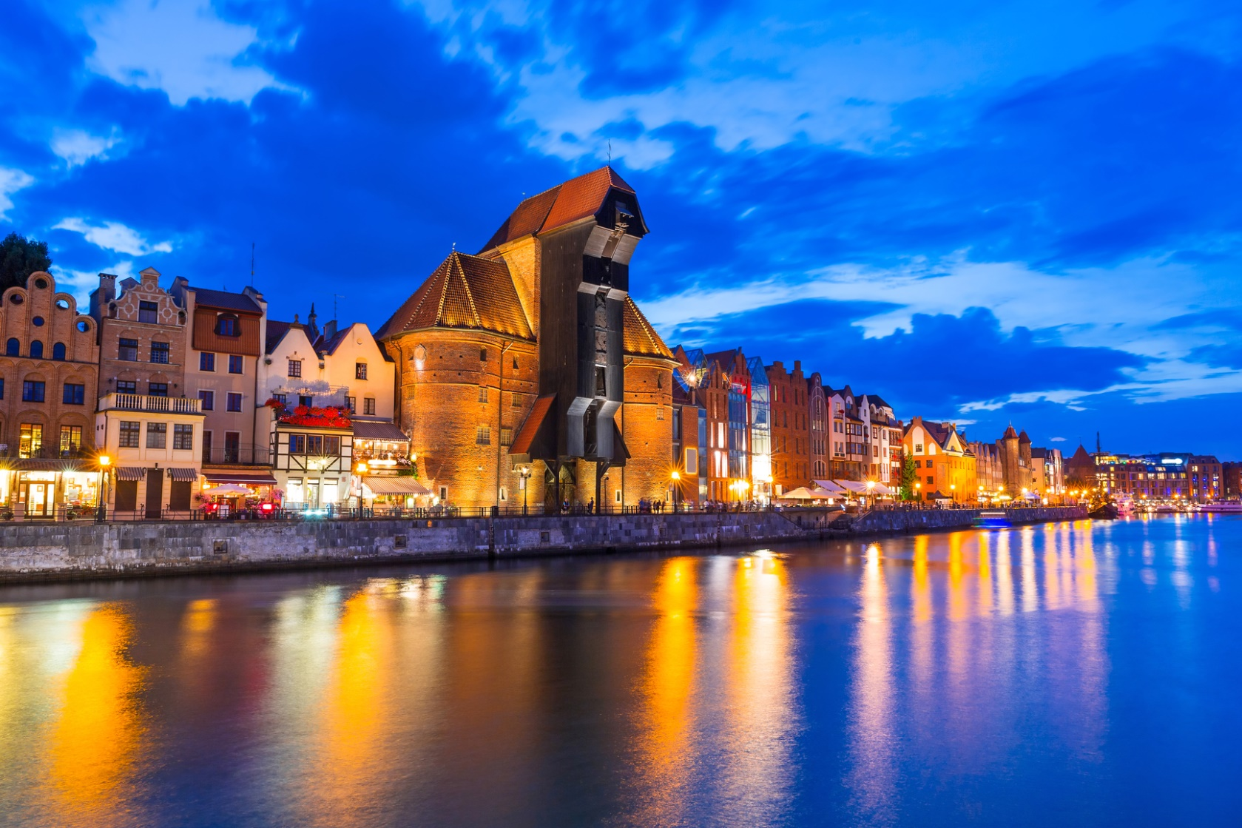
Historical Gdansk
Gdansk, 22 February 2016

Slide 5
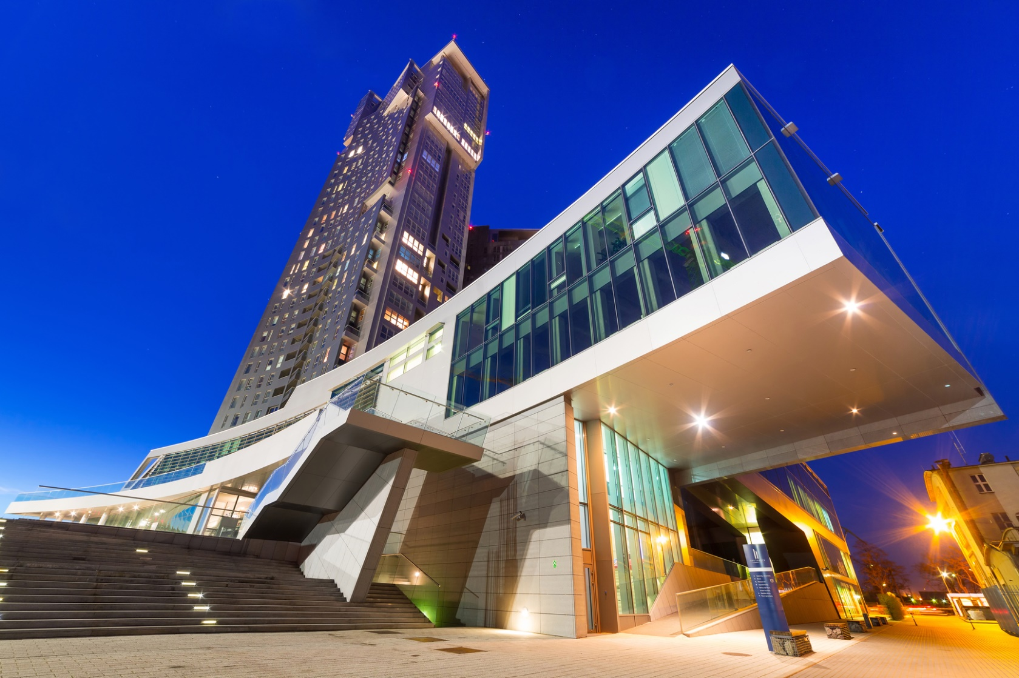
Modern Gdynia
Gdansk, 22 February 2016

Slide 6
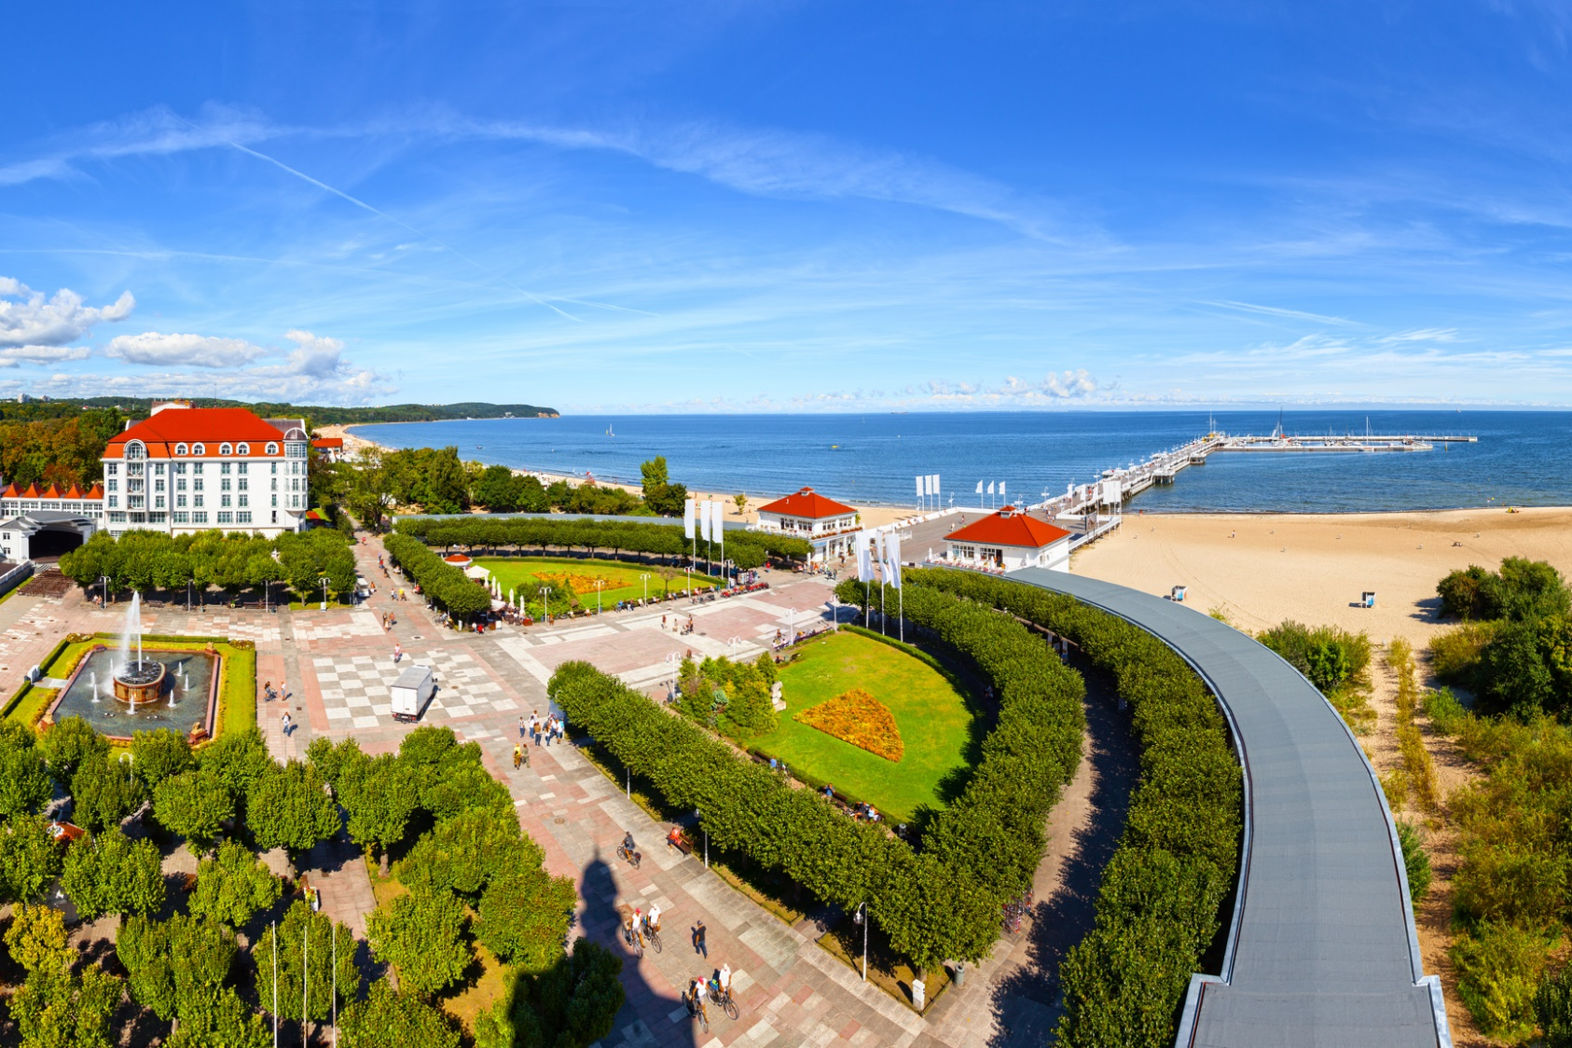
Sopot – seaside spa
Gdansk, 22 February 2016

Slide 7
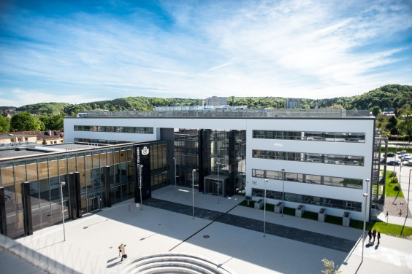
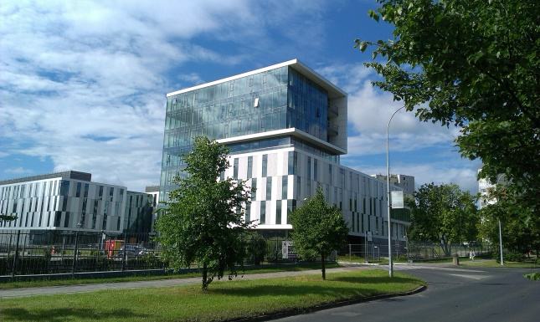
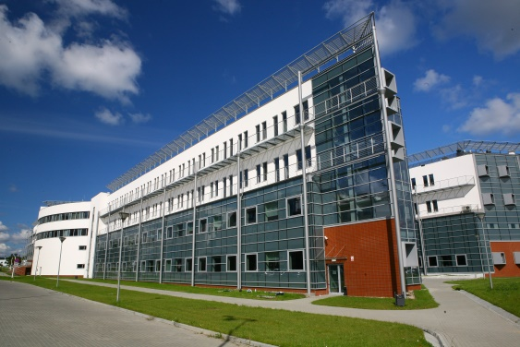
UG’s Baltic Campus
Oliwa campus consists of the following sites:
Rector’s Office
Faculties: Biology, Chemistry, Law and Administration, Languages, History, Mathematics, Physics and Informatics, new Neophilology building, Biotechnology, Faculty of Social Sciences and the Institute of Geography, Main Library and residence halls.
Plans for: construction of an Institute of Informatics and a University Center for Sport and Recreation.
Gdansk, 22 February 2016

Slide 8
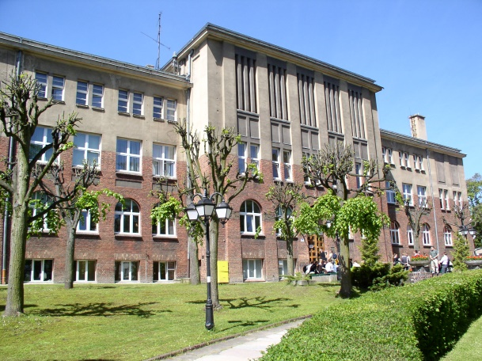
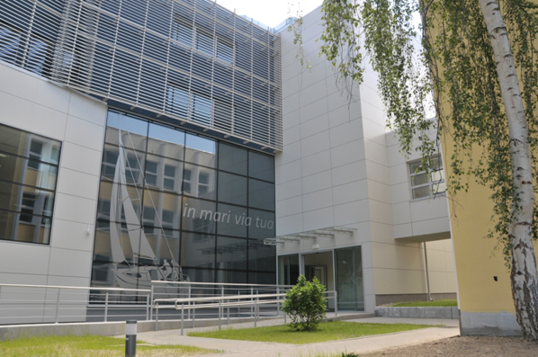
UG’s Baltic Campus
Gdynia Campus consists of:
Stylish building of the Institute of Oceanography (recognized by the Chairman of Gdynia City Council as best investment in the ‘Time for Gdynia’ competition).
Sopot Campus consists of:
New Teaching and Conference Center
Faculty of Management with the new Teaching and Conference Center
Faculty of Economics (extended this year).
Gdansk, 22 February 2016

Slide 9
UG’s Baltic Campus
Most up-to-date academic library in
northern Poland
Multimedia-equipped lecture halls
Modern laboratories
Specialized workshops
Residence halls
Bike paths
Gdansk, 22 February 2016

Slide 10
LARGEST INSTITUTION OF HIGHER EDUCATION
in northern Poland
Approx. 30 000 graduate, doctoral and post-graduate
students
Over 1670 teaching and research staff
11 faculties, Foreign Language Center and
Physical Education and Sport Center
71 courses of study
201 specializations
18 doctoral courses
104 post-graduate courses
Gdansk, 22 February 2016

Slide 11
UG’s Baltic Campus
More than 200 student circles and societies
10 foreign language courses for students
Over 1747 computer terminals available to students
Over 24 000 contracts signed with companies and institutions for training and internship
Gdansk, 22 February 2016

Slide 12
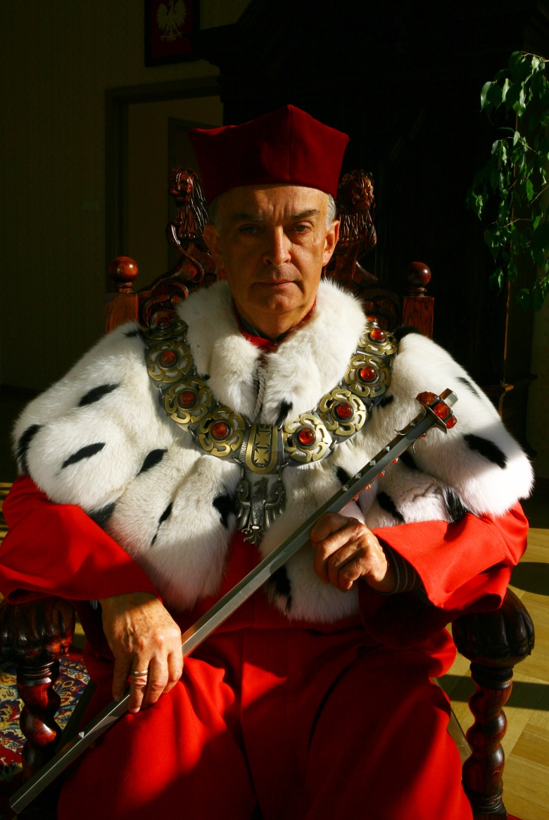
SUCCESSES
Rated best institution of higher education in the Pomeranian region by employers from all over Poland (second best by employers in the local area).
Rated 4th among universities in the 2015 academic ranking by Polityka magazine and 6th of all higher educational establishments in Poland.
7th place among universities and 15th place of 86 among academic institutions by the consumer guide ‘Perspektywy 2014’ (Perspectives 2014).
Gdansk, 22 February 2016

Slide 13
IN MARI VIA TUA
The university’s maritime face
Scientific research and teaching at the Faculty of Biology, and at the Faculty of Oceanography and Geography, which hosts a course of studies unique in Poland – Oceanography.
Scientific and educational research at other faculties conducted in:
marine environmental protection
maritime law
international maritime law
law and infrastructure of Pomeranian cities
maritime criminology
maritime transport and economics
connection between various epochs in literature with maritime issues in Pomerania
folklore of north-east Poland
mythology of the Baltic Slavs
history of Gdansk and Pomerania
Gdansk, 22 February 2016

Slide 14
WORLD-FAMOUS SCIENCE AND RESEARCH STATIONS
Institute of Oceanography’s Marine Station in Hel
research into the course of life in the Baltic
reintroduction of endangered species
Bird Migration Research Center in Przebendowo
research into bird routes and migration
‘Action Baltic’
In helping the development of the Pomeranian region, whose natural wealth is the sea, the University of Gdansk is realizing its motto ‘In mari via tua’.
Gdansk, 22 February 2016

Slide 15
INTERNATIONAL COOPERATION
Over 140 international bilateral contracts
Over 350 contracts as part of the ERASMUS+ program
International exchange of students, teaching and administrative staff
Participation in research and educational programs,
International grants,
International symposia and conferences
Participation in international scholarships as well as research and educational programs such as: Horizon 2020, the 7th Framework Programme, the Polish-Norwegian Research Programme, the Polish-Swiss Research Programme and the POKL (Human Capital Operational Programme).
Gdansk, 22 February 2016

Slide 16
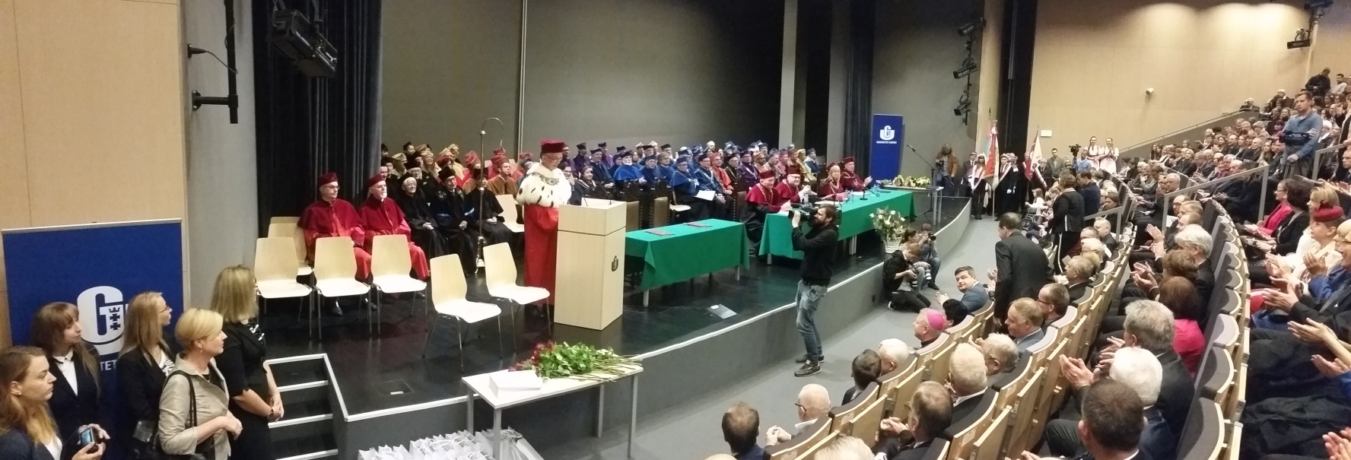
UNIVERSITY OF GDANSK FACULTIES
Faculty of Biology
UG and Medical University of Gdansk’s Intercollegiate Faculty of Biotechnology
Faculty of Chemistry
Faculty of Economics
Faculty of Languages
Faculty of History
Faculty Mathematics, Physics and Informatics
Faculty of Social Sciences
Faculty of Oceanography and Geography
Faculty of Law and Administration
Faculty of Management
Gdansk, 22 February 2016

Slide 17
COURSES
Faculty of Biology
Biology
Medical Biology
Valorization and Management of Natural Resources
Faculty of Chemistry
Business Chemistry
Chemistry
Environmental Protection
Faculty of Economics
Ecological Business and Technology
Economics
International Business Relations
Gdansk, 22 February 2016

Slide 18
COURSES
Faculty of Languages
American Studies
Kashubian Ethnolinguistics
English Philology
German Philology
Classical Philology
Polish Philology
Romance Philology
Russian Philology
Iberian Studies
Cultural Studies
Applied Linguistics
Logopedics
Russian Studies
Chinese Studies
Scandanavian Studies
Slavic Studies
Balkan Studies
Eastern Studies
Studium Humanitatis – Traditions of European Civilization
Theater Studies
Film Studies and Audiovisual Culture
Artistic Institution Management
Faculty of History
Archeology
Ethnology
History
History of Art
Regional Studies and Historic Tourism
German Studies
Religious Studies
Gdansk, 22 February 2016

Slide 19
COURSES
Faculty of Mathematics, Physics and Informatics
Nuclear Safety and Radiological Protection
Bioinformatics
Physics
Medical Physics
Informatics
Mathematics
Mathematics (in English)
Medical Physics (in English)
Physics (in English)
Faculty of Social Sciences
National Security
Diplomacy
Journalism and Social Communication
Philosophy
Pedagogy
Special Pedagogy
Pedagogy of Early Education
Political Science
Social Work
Psychology
Sociology
Gdansk, 22 February 2016

Slide 20
COURSES
Faculty of Oceanography and Geography
Geography
Geology
Spatial Economy
Water Economics and Protection of Water Resources
Marine Ichthyology
Oceanography
Faculty of Law and Administration
Administration
European Business Administration
Criminology
Taxation and Tax Consultancy
Law
Law and Administration in the Economy
Gdansk, 22 February 2016

Slide 21
Courses
Faculty of Management
Finance and Accounting
Finance and Accounting – Financial Analyst
Informatics and Econometrics
Taxation and Tax Consultancy
Management
Intercollegiate Faculty of Biotechnology
Biotechnology
Gdansk, 22 February 2016

Slide 22
THE UNIVERSITY OF GDANSK
also offers
Doctoral Studies
Post-graduate Studies
Foreign Language Courses
English, Chinese, French, Spanish, Japanese, German, Russian, Swedish, Italian, Polish for Foreigners
An e-learning program for teaching Polish to foreigners
Gdansk, 22 February 2016

Slide 23
NOT JUST STUDYING!
The University’s Academic Cultural Center
Academic choir, which has won the world’s top prizes
JANTAR Song and Dance Ensemble
Student Photographic Agency
University Film Chronicle
‘The Loves of a Blonde’ Film Club
and literary club
University Cultural Collective
happenings, meetings, exhibitions
Gdansk, 22 February 2016

Slide 24
The University’s Academic Sports Union
Sport Aerobics
Badminton
Judo
Shotokan Karate
Mountain Biking
Basketball
Light Athletics
Skiing
Hang-gliding
Soccer
Handball
Swimming
Volleyball
Snowboarding
Powerlifting
Dance – Cheerleaders
Tennis and Table Tennis
Tourism
Climbing
Gdansk, 22 February 2016

Slide 25
Student Scientific Circles and Organizations
Over 205 student scientific circles across all faculties
International Associations and Organizations – AIESEC, AEGEE, ELSA
Programs for students:
ERASMUS - International Student Exchange Program
MOST Program
Training and internships in institutions and businesses all over Poland and abroad
Gdansk, 22 February 2016

Slide 26
THANK YOU FOR YOUR ATTENTION
Gdansk, 22 February 2016

