Slide 1
University of Gdańsk
www.ug.edu.pl

Slide 2
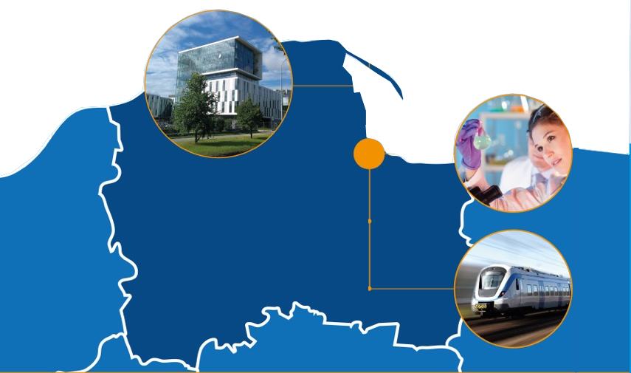
Tri-city Metropolis
Gdańsk, Gdynia, Sopot

Slide 3
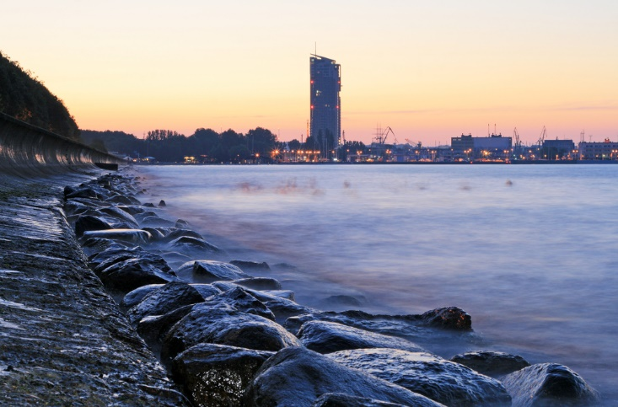
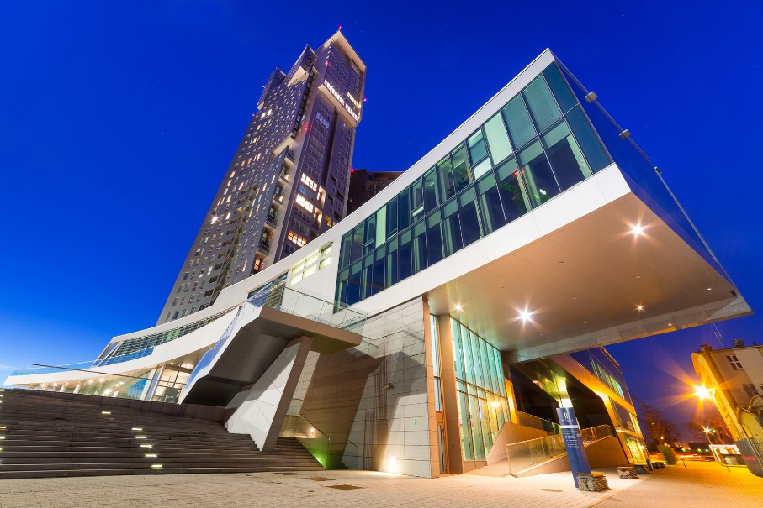
Tri-city Metropolis
GDYNIA

Slide 4
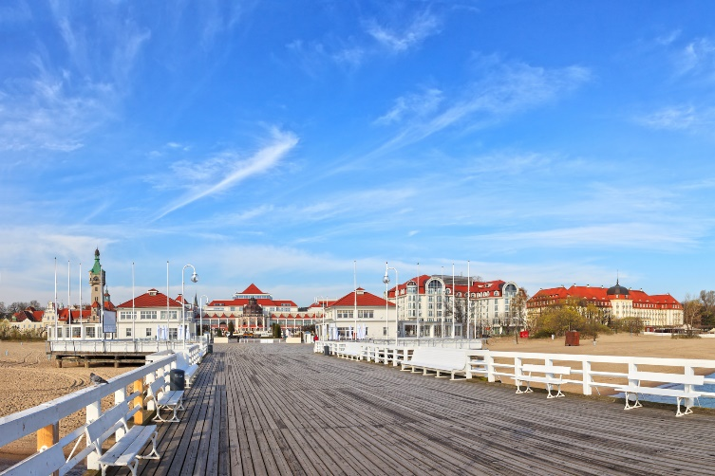
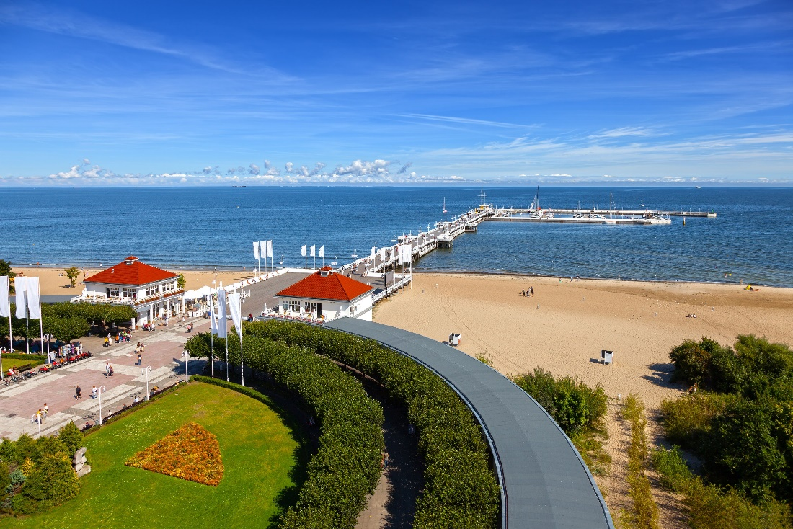
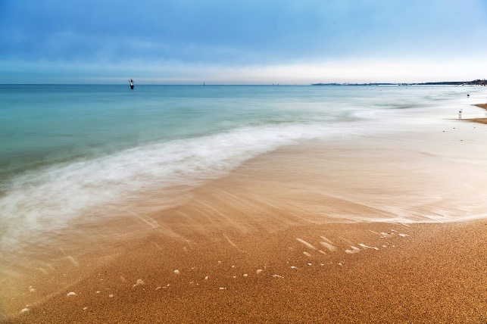
Tri-city Metropolis
SOPOT

Slide 5
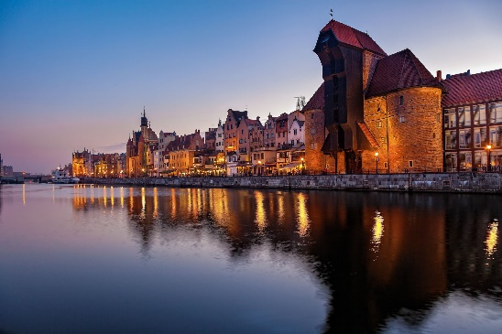
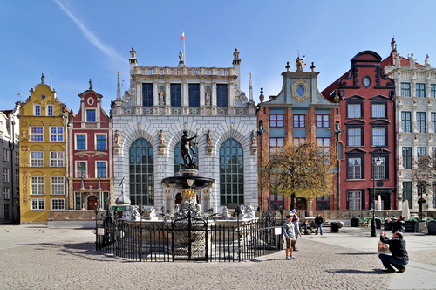
Tri-city Metropolis
GDAŃSK

Slide 6
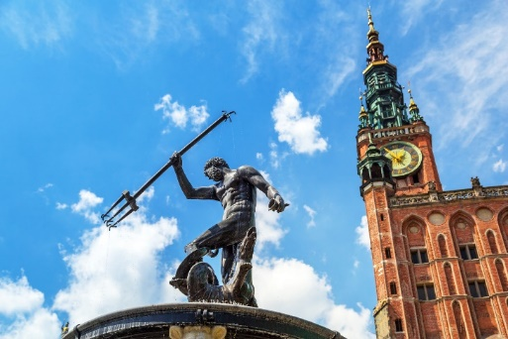
Tri-city Metropolis
Seaside SPA SOPOT, modern GDYNIA & historical GDAŃSK
Population of approximately 1.3 million
Tri-city Landscape Park, known as the "lungs of the Tri-City", covers an area of 20ha and provides fresh air, free from smog
Seaside location
Efficient public transport (bus, streetcar, rapid transport railroad)
Access to highway system
Regional and international railroad connections

Slide 7
Tri-city Metropolis
Seaside SPA SOPOT, modern GDYNIA & historical GDAŃSK
Strategic location in Central Europe
Investor and innovator hubs
Close cooperation between local authorities, universities, business entities and science and technology institutions
Varied and specialized workforce

Slide 8
LARGEST INSTITUTION OF HIGHER EDUCATION
in northern Poland
28 000 graduate, doctoral and post-graduate students
1757 teaching and research staff
11 faculties
77 courses of study
223 specializations
20 doctoral courses
104 post-graduate courses
7 foreign language courses for students
offered by the Foreign Language Center
and others: English, French, Spanish, Italian,
German, Russian, Swedish, Norwegian,
Chinese, as well as Polish for Foreigners
Over 24 000 contracts signed with companies and institutions for training and internship
8

Slide 9
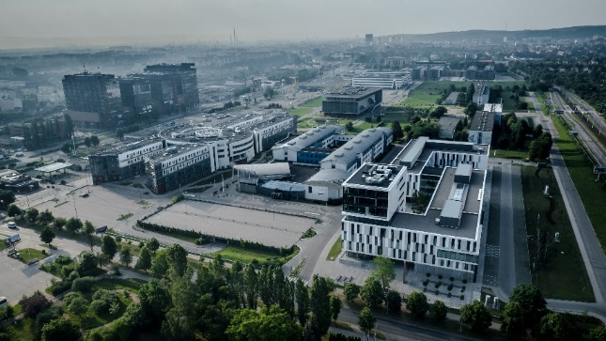
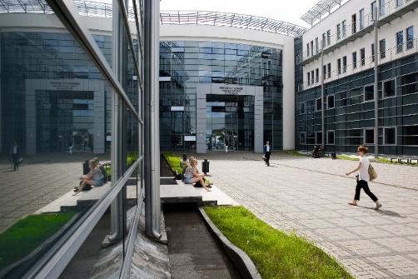
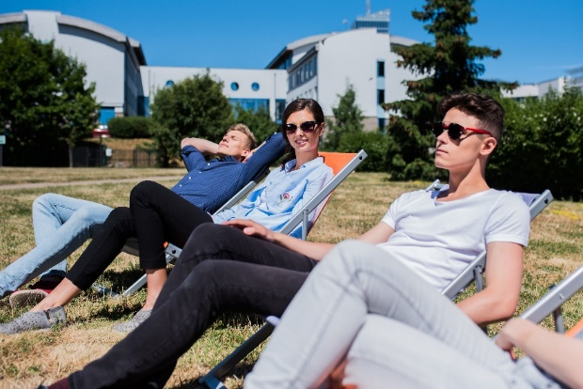
UG’S BALTIC CAMPUS
THE OLIWA CAMPUS
Rector’s Office
Faculties of Biology, Chemistry, History, Law and Administration, Languages, Mathematics, Physics and Informatics, Biotechnology, new Neo-philology building, Faculty of Social Sciences and Institute of Geography Most up-to-date and the largest academic library in northern Poland
4 residence halls in close proximity to the campus
Plans for the construction of: - Institute of Informatics - University Sports and Recreation Center

Slide 10
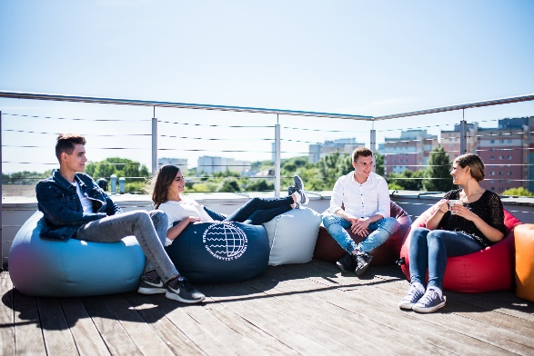
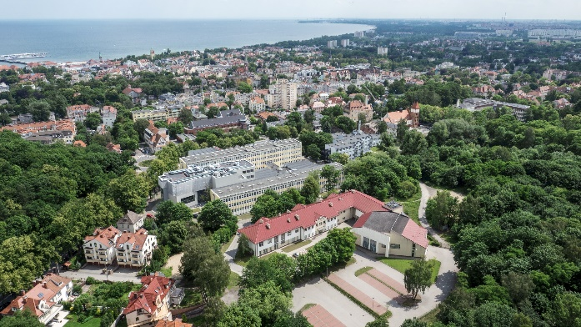
UG’S BALTIC CAMPUS
GDYNIA & SOPOT CAMPUS
The Gdynia Campus consists of:
The stylish building of the Institute of Oceanography (recognized by the Chairman of Gdynia City Council as the best investment in the ‘Time for Gdynia’ competition)
The Sopot Campus consists of:
The new Teaching and Conference Center
The Faculty of Management with the new Teaching and Conference Center
The Faculty of Economics

Slide 11
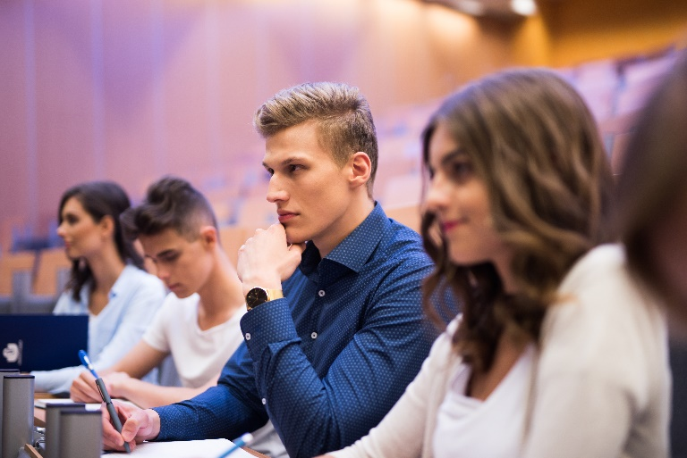
UG’S BALTIC CAMPUS
Most up-to-date academic library in
northern Poland
Multimedia-equipped lecture halls
Modern laboratories
Specialized workshops
Residence halls
Bike paths

Slide 12
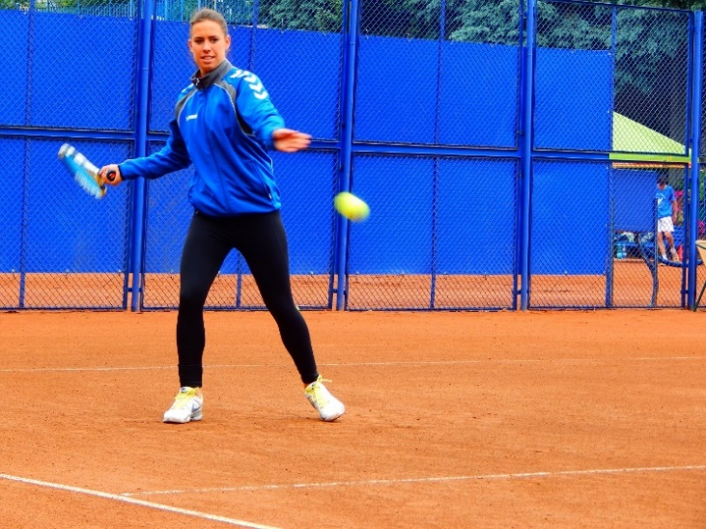
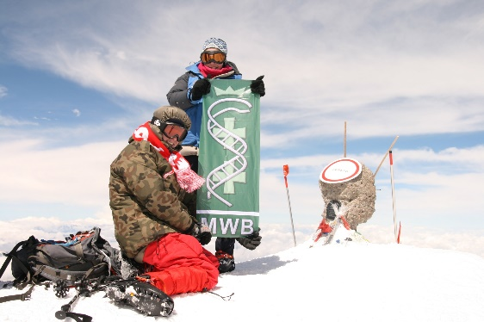
STUDENT SCIENTIFIC CIRCLES AND ORGANIZATIONS
About 191 student scientific circles across all faculties
Programs for students:
ERASMUS ─ International Student Exchange Program
MOST Program ─ National Exchange Program
Training and internships in institutions and businesses all over Poland and abroad
International Associations and Organizations ─ AIESEC, AEGEE, ELSA
More than 20 sports divisions within the Physical Education and Sports Center and the Academic Sports Association
The University’s Academic Cultural Center brings together nearly 20 interest groups

Slide 13
INTERNATIONAL PROJECTS
The International Centre for Cancer Vaccine Science
(41 M PLN funding)
International Centre for Theory of Quantum Technologies
(38 M PLN funding)

Slide 14
ACADEMIC RESEARCH RELATED TO THE BALTIC SEA REGION AND ENVIRONMENT:
Research areas at other faculties of the University of Gdańsk include:
Faculty of Economics:
maritime transport and economics
seaborne trade
maritime tourism
Faculty of History:
history and culture of Gdańsk and Pomerania
multiculturalism in Pomerania
Polish-German relations in the context of Pomeranian history
anti-communist opposition – Pomerania,1945-1989
history of architecture in the Baltic region
Faculty of Languages:
maritime literature
folklore of north-eastern Poland
Kashubian language and dialectology
Balto-Slavic mythology
Faculty of Social Sciences:
cultural sociology of Pomerania and the Tri-City, particularly the Kashubian region
international relations in the Baltic Sea region
Faculty of Law and Administration:
maritime law (national and international)
law and Infrastructure of Pomeranian cities
maritime criminology

Slide 15
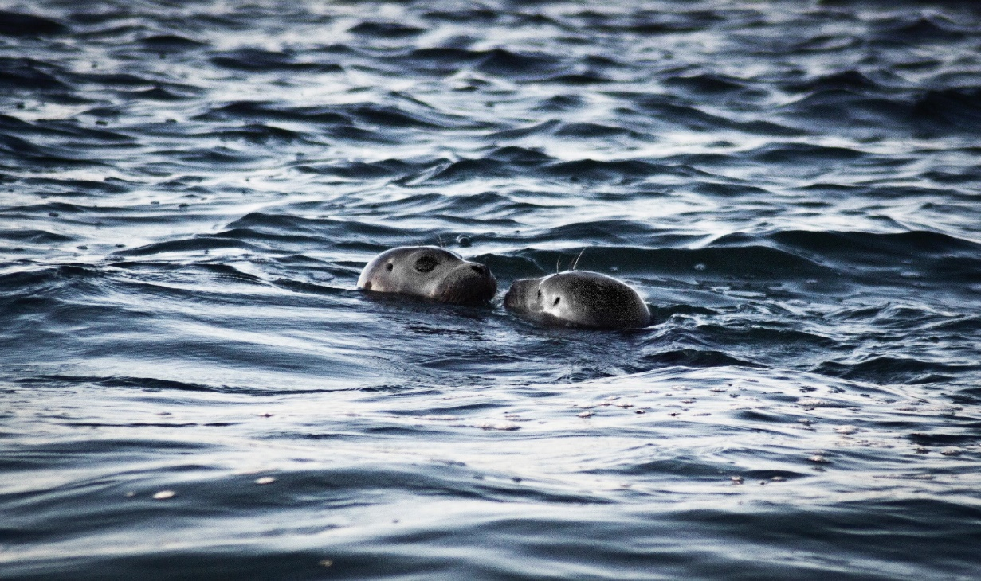
WORLD-FAMOUS SCIENCE AND RESEARCH STATIONS
The Institute of Oceanography’s Marine Station in Hel
Seal Center in Hel (more than 400,000 visitors per year)
‘Oceanograf 2’, cutting-edge research vessel of the University’s Institute of Oceanography, launched in 2016
research into the course of life in the Baltic Sea
reintroduction of endangered marine species
‘Blue school’ educational program for high school students

Slide 16
INTERNATIONAL COOPERATION
Cooperation with 120 universities from most countries in Europe and worldwide.
International exchange of students, teaching and administrative staff:
Over 190 international bilateral contracts
Over 460 contracts as part of the ERASMUS+ program
Participation in the international and national development programmes e.g.:
Horizon 2020
University has already participated in the implementation of 73 projects under the Framework Programmes and Horizon 2020. Crystal Brussels Prize received in 2013 in the category of Research and Development Units.
Interreg Baltic Sea Region,
Interreg South Baltic Programme,
Regional Operational Programme for the Pomeranian Voivodeship,
Operational Programme Knowledge Education Development,
Operational Programme Smart Growth,

Slide 17
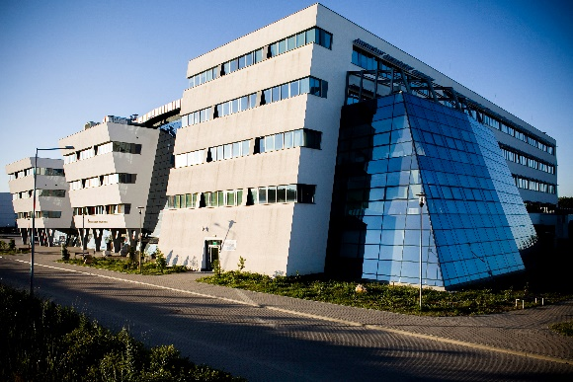
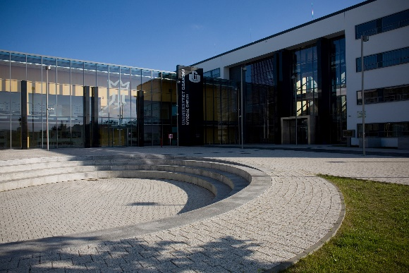
UNIVERSITY OF GDAŃSK FACULTIES
Faculty of Chemistry
Business Chemistry
Chemistry
Environmental Protection
Biology
Medical Biology
Valorization and Management
of Natural Resources

Slide 18
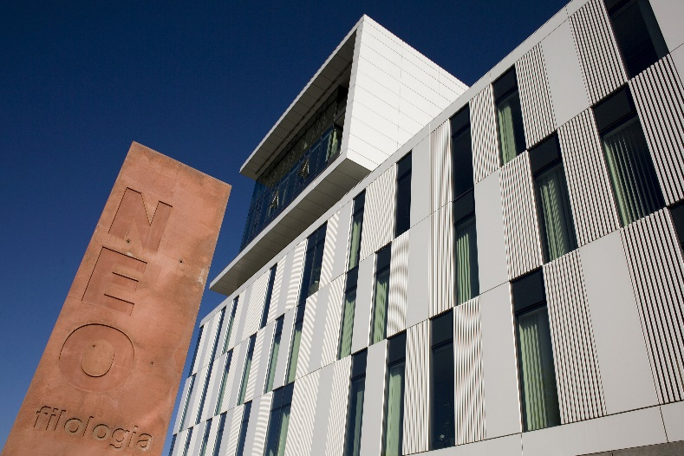
UNIVERSITY OF GDAŃSK FACULTIES
Faculty of History
Archeology
Ethnology
History
History of Art
Regional Studies and Historic Tourism
German Studies
Religious Studies
Faculty of Languages
American Studies
Kashubian Ethnolinguistics
English Philology
German Philology
Classical Philology
Polish Philology
Romance Philology
Russian Philology
Iberian Studies
Cultural Studies
Applied Linguistics
Logopedics
Russian Studies
Chinese Studies
Scandanavian Studies
Slavic Studies
Balkan Studies
Eastern Studies
Studium Humanitatis – Traditions of European Civilization
Theater Studies
Film Studies and Audiovisual Culture
Artistic Institution Management

Slide 19
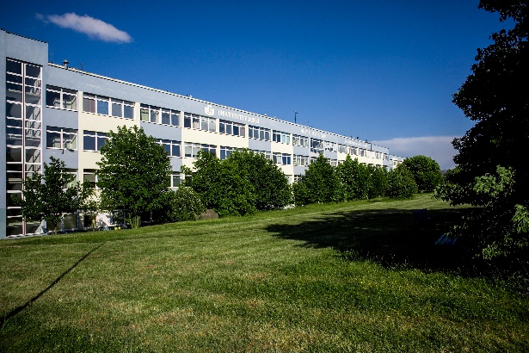
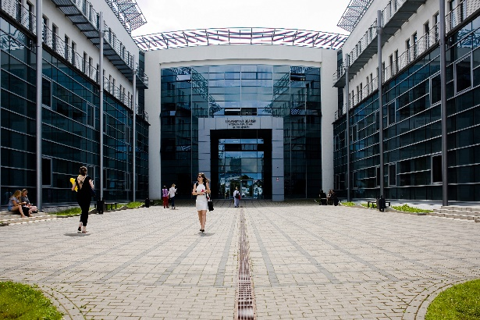
UNIVERSITY OF GDAŃSK FACULTIES
Faculty of Mathematics, Physics and Informatics
Nuclear Safety and Radiological Protection
Bioinformatics
Physics
Medical Physics
Informatics
Mathematics
Mathematics (in English)
Medical Physics (in English)
Physics (in English)
Faculty of Social Sciences
National Security
Diplomacy
Journalism and Social Communication
Philosophy
Pedagogy
Special Pedagogy
Pedagogy of Early Education
Political Science
Social Work
Psychology
Sociology

Slide 20
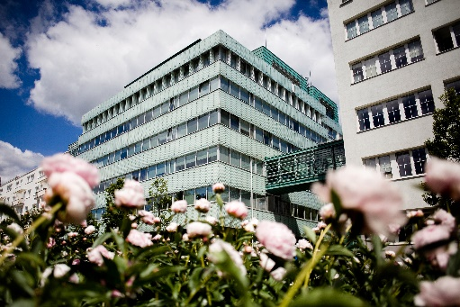
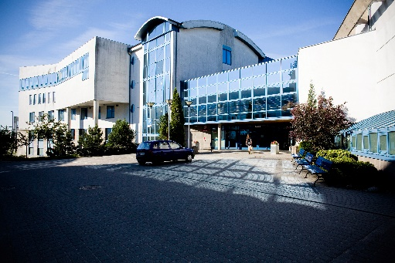
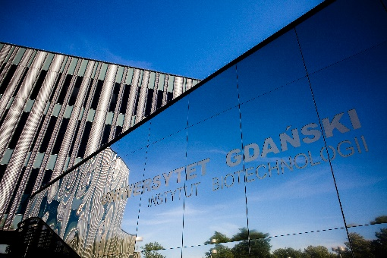
UNIVERSITY OF GDAŃSK FACULTIES
Faculty of Oceanography and Geography
Geography
Geology
Spatial Economy
Water Economics and Protection
of Water Resources
Marine Ichthyology
Oceanography
Faculty of Law and Administration
Administration
European Business Administration
Criminology
Taxation and Tax Consultancy
Law
Law and Administration in the Economy
Intercollegiate Faculty of Biotechnology
Biotechnology

Slide 21
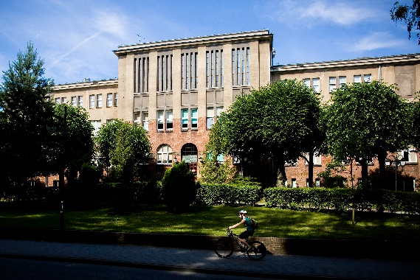
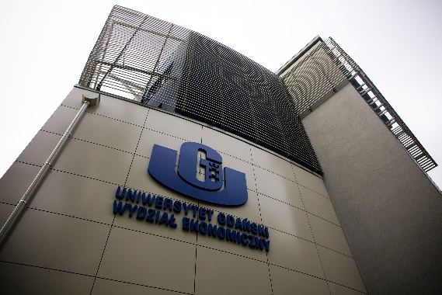
UNIVERSITY OF GDAŃSK FACULTIES
Faculty of Management
Finance and Accounting
Finance and Accounting – Financial Analyst
Informatics and Econometrics
Taxation and Tax Consultancy
Management
Faculty of Economics
Ecological Business and Technology
Economics
International Business Relations

Slide 22
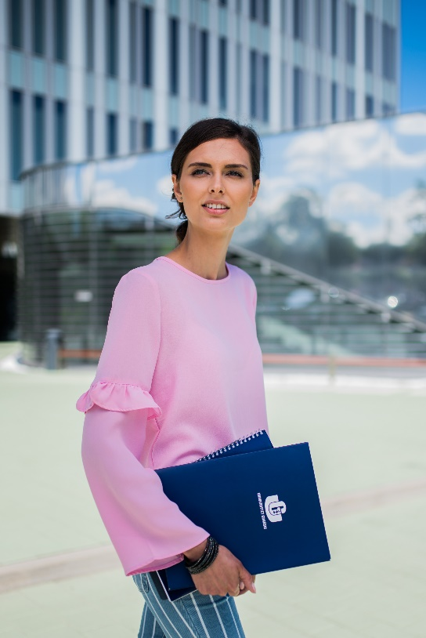
THE UNIVERSITY OF GDANSK also offers
Doctoral Studies
Post-graduate Studies
Foreign Language Courses
English, Chinese, French, Spanish, Japanese, German, Russian,
Swedish, Italian, Polish for Foreigners
An e-learning program for teaching Polish to foreigners

Slide 23
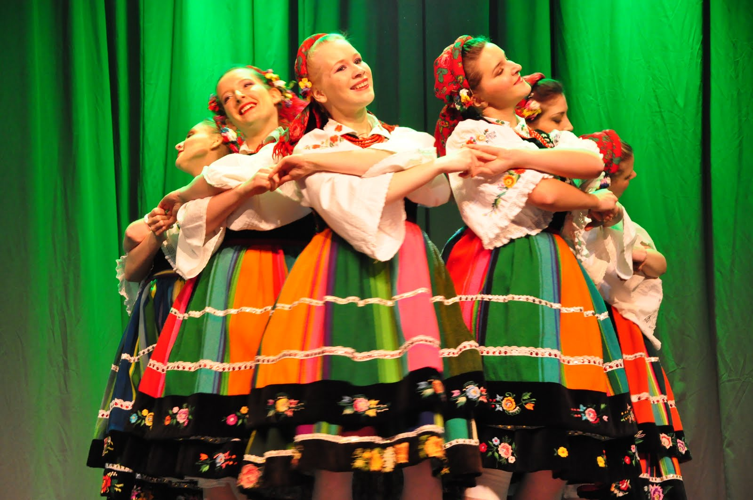
THE UNIVERSITY OF GDANSK also offers
Academic choir, which has won the world’s top prizes
JANTAR Song and Dance Ensemble
Student Photographic Agency
University Film Chronicle
‘The Loves of a Blonde’ Film Club and literary club
University Cultural Collective
happenings, meetings, exhibitions

Slide 24
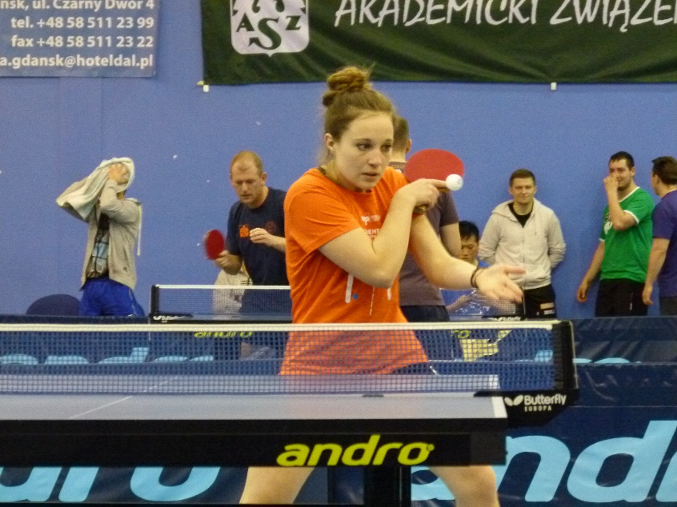
The University’s Academic Sports Union
Sport Aerobics
Badminton
Judo
Shotokan Karate
Mountain Biking
Basketball
Light Athletics
Skiing
Hang-gliding
Soccer
Handball
Swimming
Volleyball
Snowboarding
Powerlifting
Dance – Cheerleaders
Tennis and Table Tennis
Tourism
Climbing

Slide 25
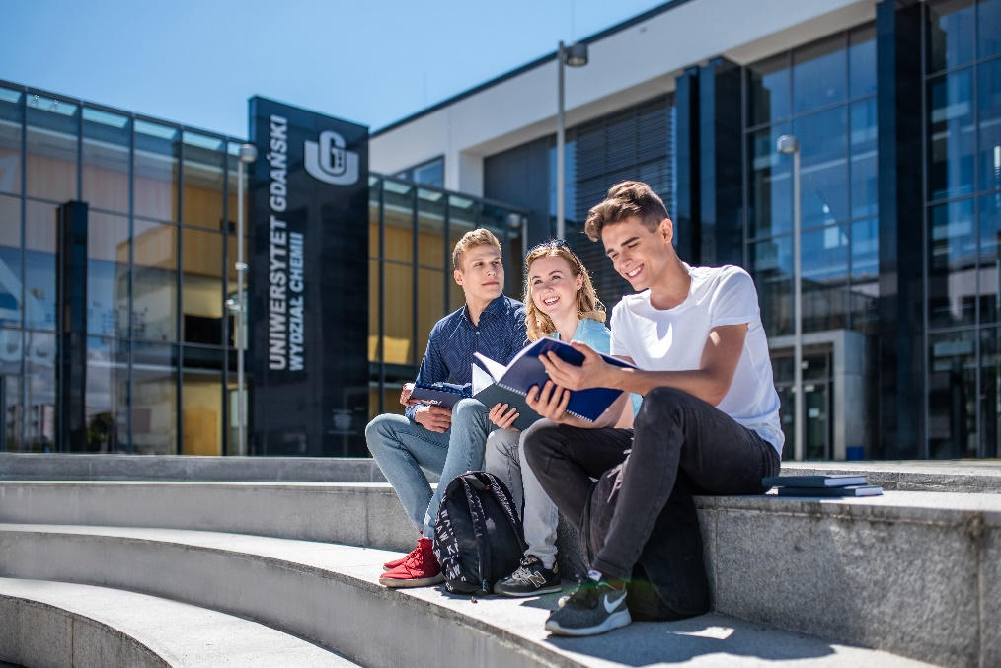
Student Scientific Circles and Organizations
Over 200 student scientific circles across all faculties
International Associations and Organizations – AIESEC, AEGEE, ELSA
Programs for students:
- ERASMUS - International Student Exchange Program
- MOST Program
- Training and internships in institutions and businesses
all over Poland and abroad

Slide 26
Thank You

